Slide 1
PANDRE SAI NITHIN
Final Project
3/21/2024 Annual Review

Slide 2
Project Title : Key Logger and Security
3/21/2024 Annual Review

Slide 3


AGENDA
Introduction
Problem Statement
Project Overview
Who are the end users?
Your solution and its value proposition
The WOW in our solution
Modelling
Results
Project link
3/21/2024 Annual Review

Slide 4
Introduction
Key Logger:
Key Logger is the action of recording the keys stroke on a keyboard.
It uses log files to retrieve information.
Common Uses:
Employee Monitoring, security surveillance, self-monitoring, etc.
Types of Key Logger:
Software Key Logger
Hardware Key Logger
Requirements for Software Key Logger:
Tools: Python version 3.8.0 or more
Libraries: Pynput & json
3/21/2024 Annual Review
4

Slide 5

PROBLEM STATEMENT
Keylogging techniques is helpful to emphasize the responsible use of these techniques in real life.
It is about developing an educational keylogger using Python. The purpose of this project is to explore how one can understand keylogging technology and its implementation on our daily basis.
We shall use pynput library to create a keylogger that captures keystrokes in real time and keeps them locally.
This tool would function as a learning tool for students and also who specialize in cybersecurity.
It helps in protecting sensitive information from keylogger attacks.
3/21/2024 Annual Review

Slide 6

PROJECT OVERVIEW
Our main objective in this project, is to bring out the importance of explicit consent and legality as key elements, ensuring that keylogging technology works constructively as an ethical instrument for real life applications. For example, this will enhance understanding of the techniques used by hackers including insider threat attacks such as phishing attack.
The most significant part focuses on making a tool that does not just capture and record typed keys as they are pressed, but also highlights responsibility and legality.
Our project hopes to include the basic functions such as keystroke recording as well as advanced features like time stamp logging for detailed activity monitoring, email notification for remote supervision and hidden operation mode for secret recording
3/21/2024 Annual Review

Slide 7

WHO ARE THE END USERS?
A wide range of customers and organizations with different objectives and aims are the end users of this Python-based keylogger. Cybersecurity experts, IT departments or any other security professional can use the keylogger for security monitoring purposes.
Categories of End Users:
Employee Monitoring
Security surveillance
Self-monitoring
Parental Monitoring
3/21/2024 Annual Review

Slide 8

YOUR SOLUTION AND ITS VALUE PROPOSITION
This project provides a Python-based keylogger intended to help understand keylogging technology completely while prioritizing moral use and accountable usage.
Using the pynput library, our keylogger precisely tracks and records keystrokes currently made, which provide the basic functionality as well as advanced features.
Keylogger may be used as an effective teaching aid for those studying cybersecurity.
Protection against Keylogger attacks:
Install firewall in your PC/Computer
Install anti virus software
Turn on Two-step authentication
Frequently update your system
3/21/2024 Annual Review

Slide 9

THE WOW IN YOUR SOLUTION
Major wow factors are:
Ease to use
Keylogger is easy to use
Innovative approach
Design for user comprehensive approach
Detection accuracy
Almost 99% accuracy for known keylogger
3/21/2024 Annual Review
9

Slide 10
MODELLING
Keystroke capture:
It utilizes the pynput library to record every keystroke in real-time.
Data logging
Saves the captured keystrokes into a secure text file.
Background operation
Keylogger runs discreetly without altering the user or affecting system performance.
File storage
We can manage the storage of log file ensuring data is accessible.
3/21/2024 Annual Review
10

Slide 11
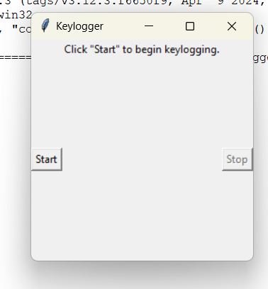
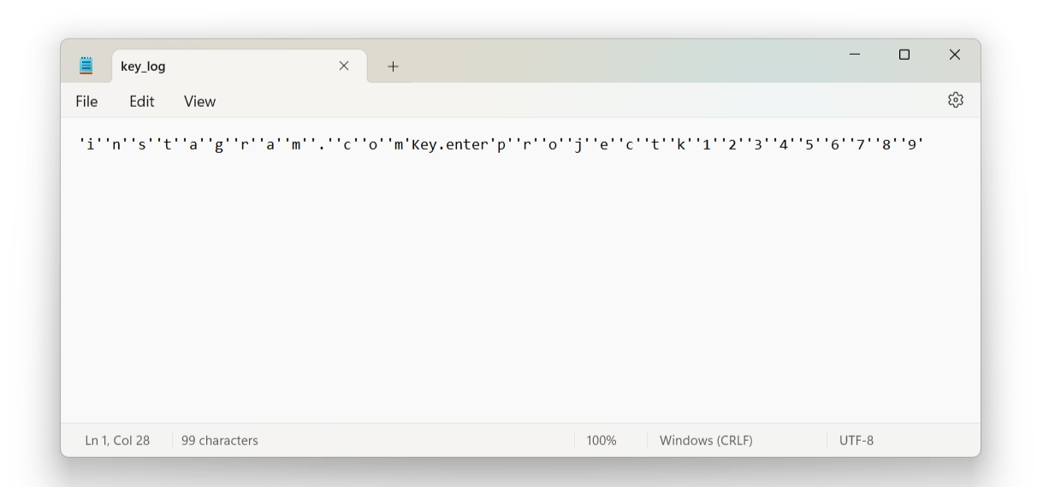
RESULT
Output:
Successfully implemented Keylogger which not only captures keystrokes and also records the in both LOG file and JSON file
3/21/2024 Annual Review
11

Slide 12
PROJECT LINK
3/21/2024 Annual Review
12

